Slide 1

City Measure
By. Marquise Trawick

Slide 2



System Configuration
Software
Python
Visual Studio Code
Anaconda
MongoDB Compass
JSON
Pymongo
Pandas
Numpy
Re
Unidecode
Geopy
Time
Matplotlib

Slide 3
Data Analytic Goal
Measure the similarity between the cities, by their businesses.

Slide 4
Data Processing
Yelp Data
Raw Json
Data Process
Insert json Entries into MongoDB Compass
Move Chosen Fields into Data Frame
Transformation
Cleaning
Normalization

Slide 5
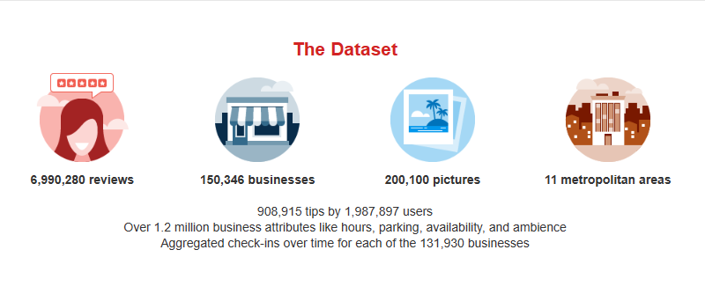
Yelp
Notes:
It is an open data

Slide 6
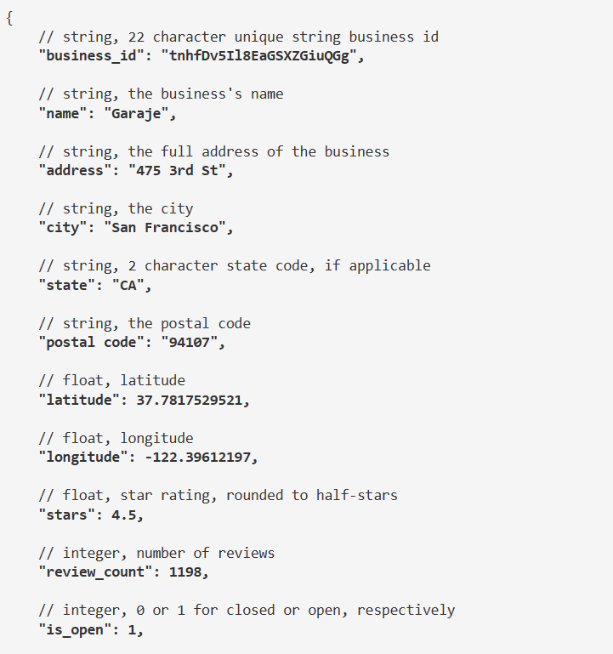
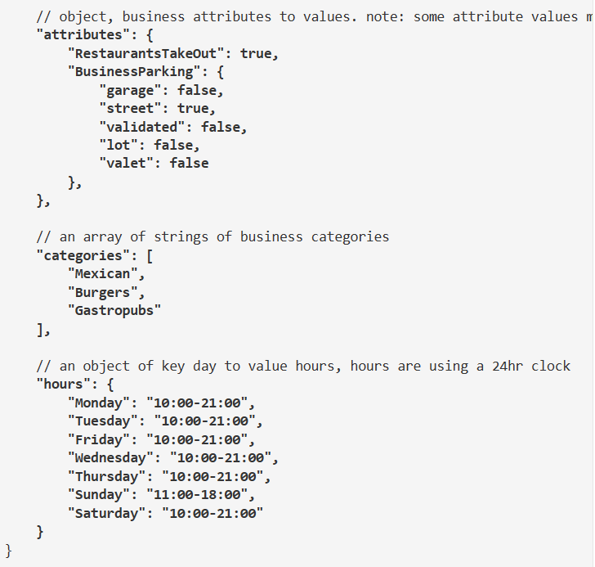
Raw JSON

Slide 7

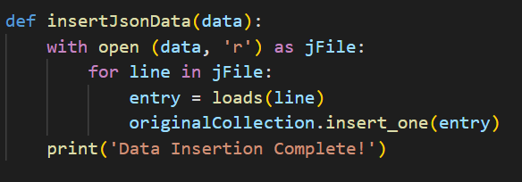
Insert Json Entry into MongoDB
Notes:
Connecting to MongoDb Compass
Insert the entries into MongoDB

Slide 8
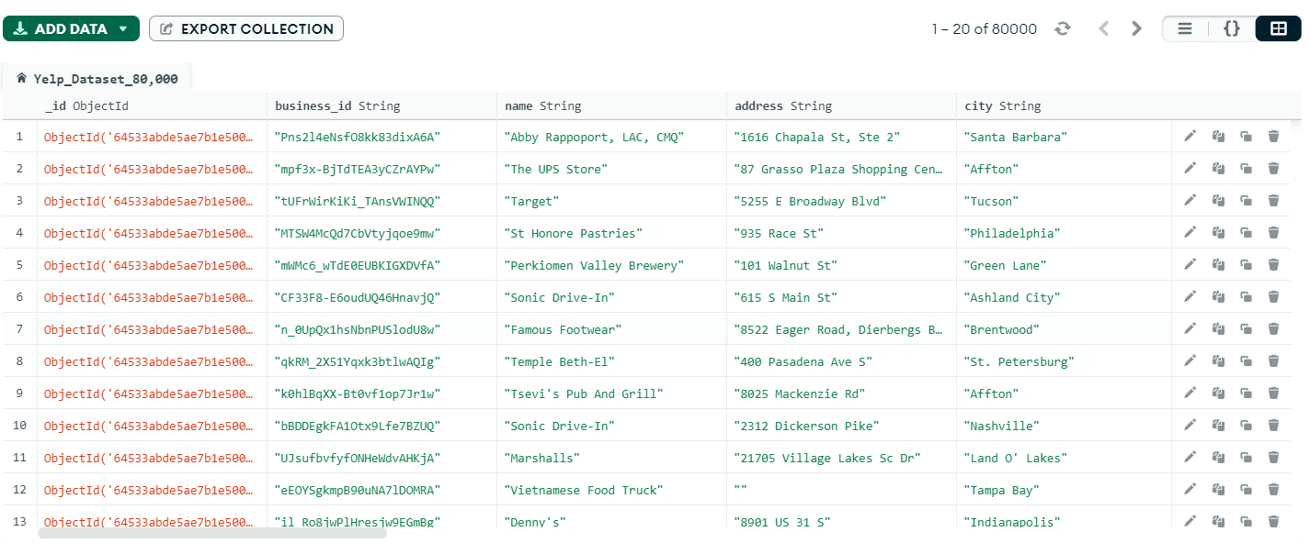

Slide 9
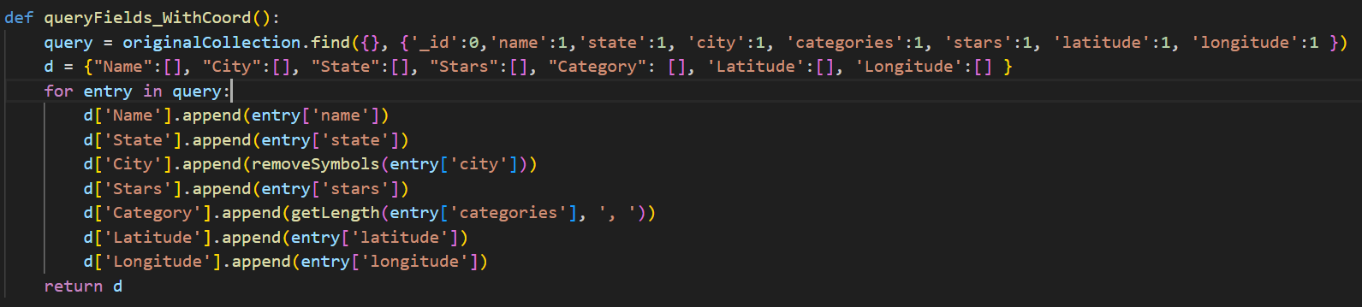
Move Chosen Fields into Data Frame
Business Name
State
City
Caterories (length)
Stars
Latitude
Longitude

Slide 10
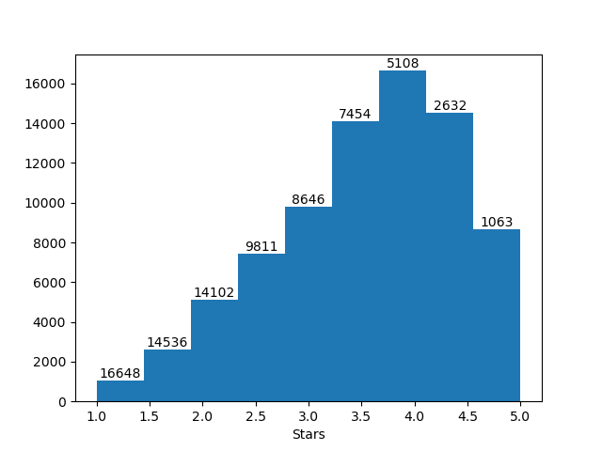
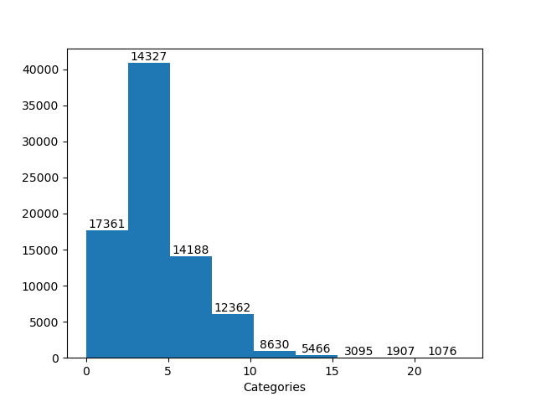
Histograms

Slide 11
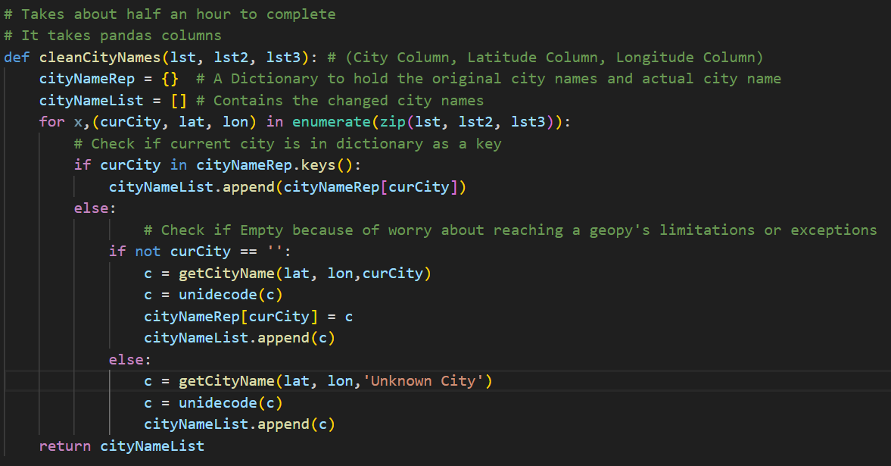
Cleaning Data

Slide 12
Cleaning Data
Geopy Limitations
Solutions
Can only perform 86,000 request a day
Can only perform 1 request a second
22 hours to clean every city
Having less entries than the request limit
Using the Sleep module to wait 1 second.
Saved every entry that needed to use geolocation
Notes:
There are 77500 entries
Some simple abreviations such as north, mount and fort are ok. But some Cities are a such as MMRP for McDowell Mountain Regional Park are not helpful.
There were only two empty cities but one of those entries only had the state written in the address.
Although yelp business dataset had only 77500 entries but that was still take 21.5 hours
Abreviated, Mispelled or empty cities City Names of which a majority was solved by Geopy
Sleep(1)
77500 sec or 21.5 hours

Slide 13
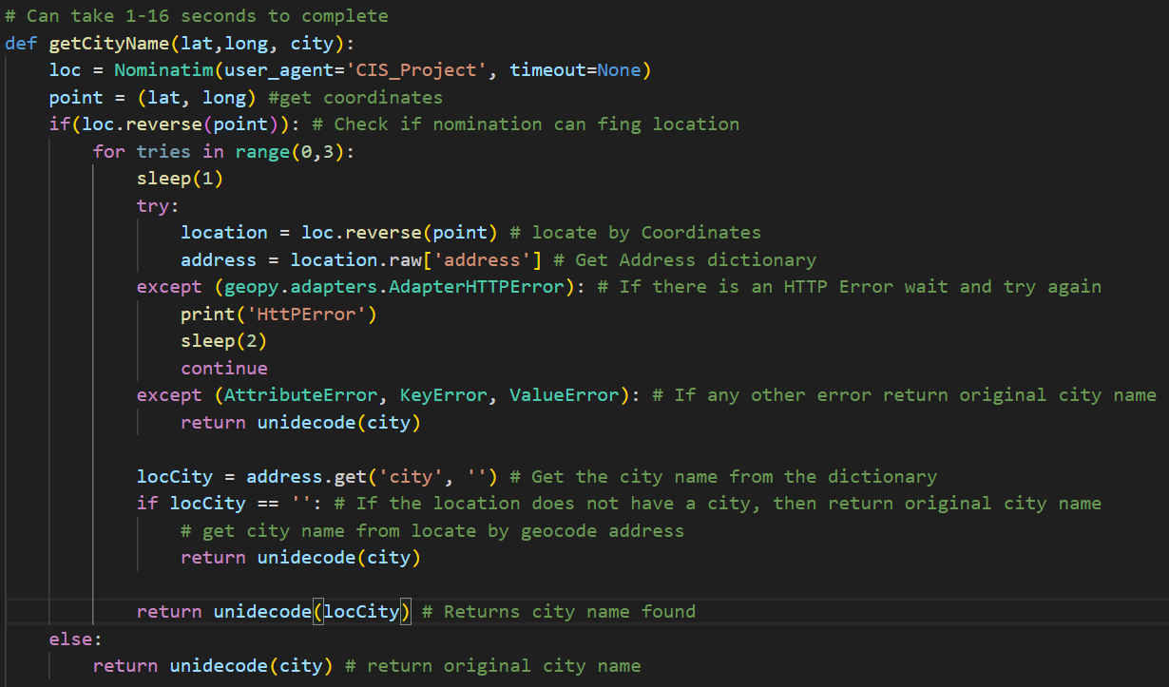
Geolocation

Slide 14
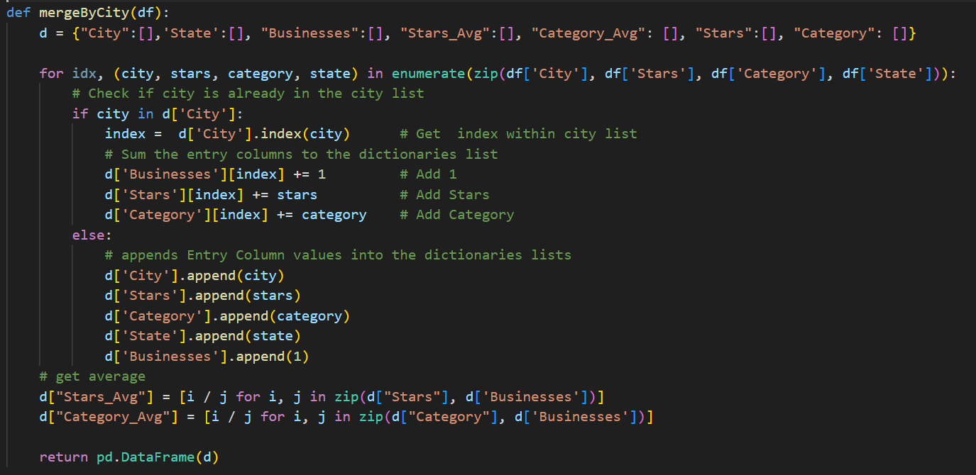
Merging

Slide 15
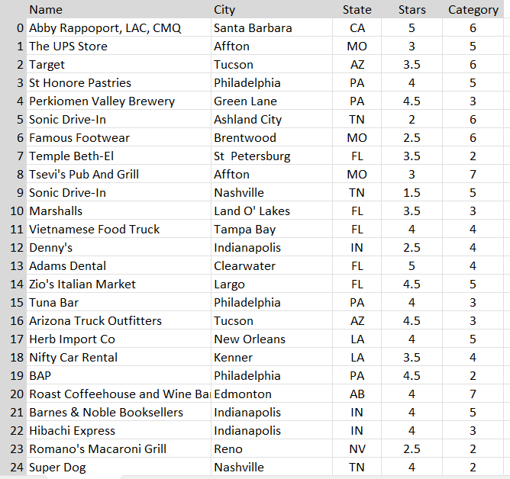
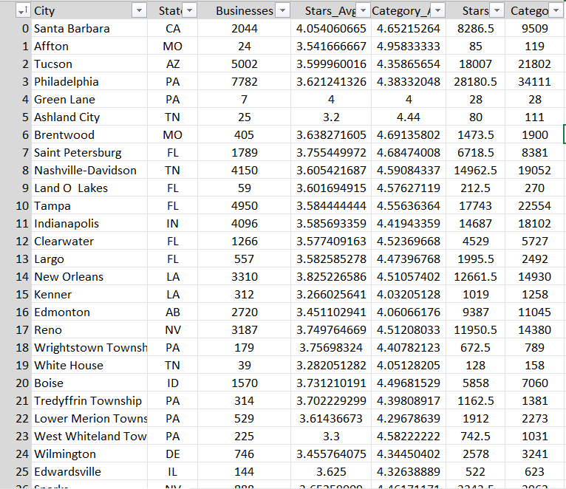
Before
After

Slide 16
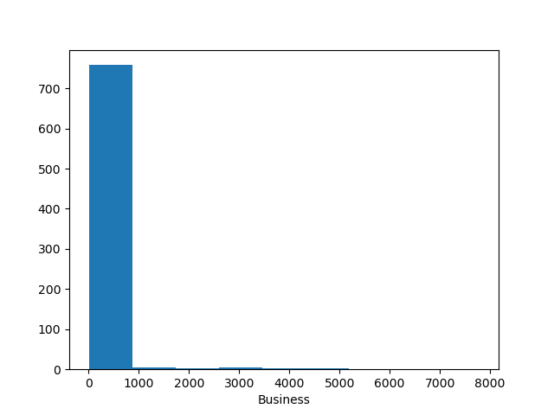
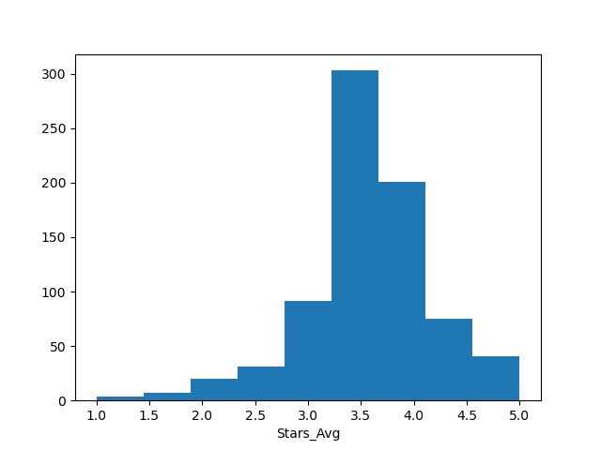
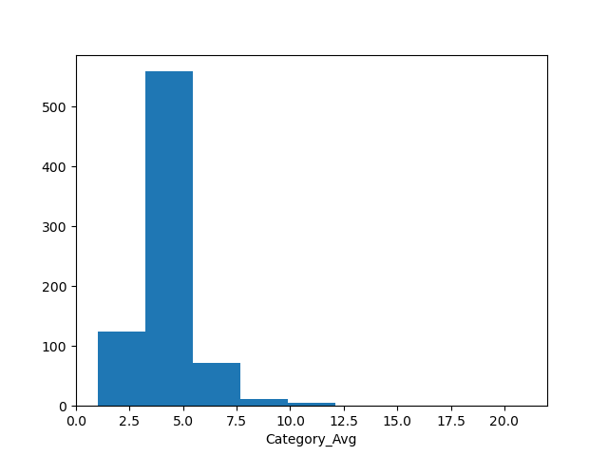
Histogram
Business
Count | 773
Mean | 103.493
STD | 503.936
Min | 1
25% | 1
50% | 8
75% | 44
max | 7782
Stars_Avg
Count | 733
Mean | 3.585
STD | 0.646
Min | 1
25% | 3.286
50% | 3.550
75% | 3.921
max | 5
Category_Avg
Count | 773
Mean | 4.344
STD | 1.404
Min | 1
25% | 3.800
50% | 4.304
75% | 4.740
max | 21

Slide 17
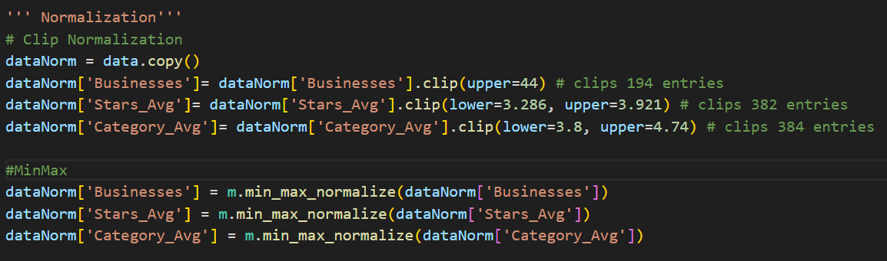
Transformation
Combing by Cities
Norm by Clip
Min-Max Normalization
Notes:
Clipped with an upper limit of 1000
Stars are Ordinal Categorical Data
Categories were Nominal Categorical Data

Slide 18
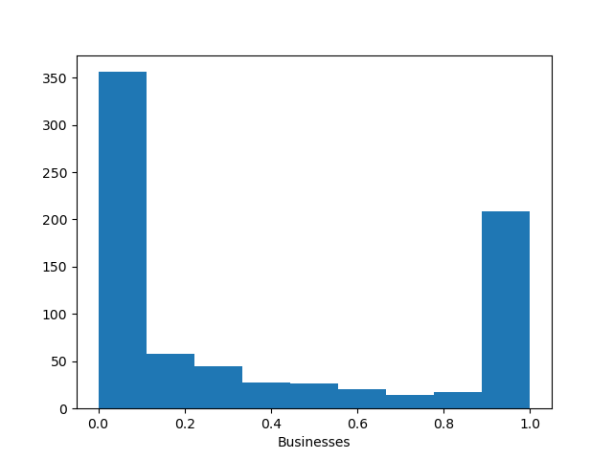
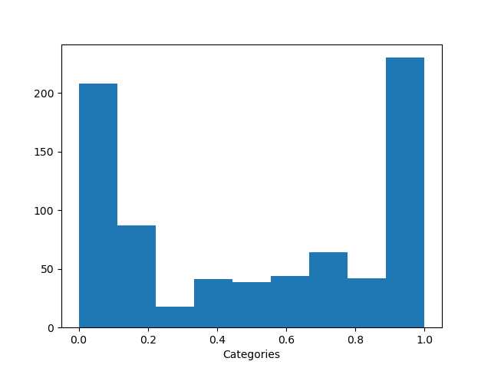
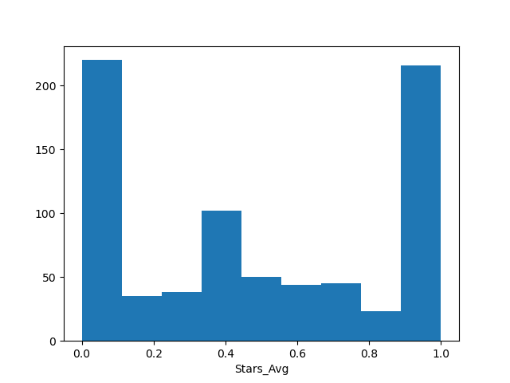

Slide 19
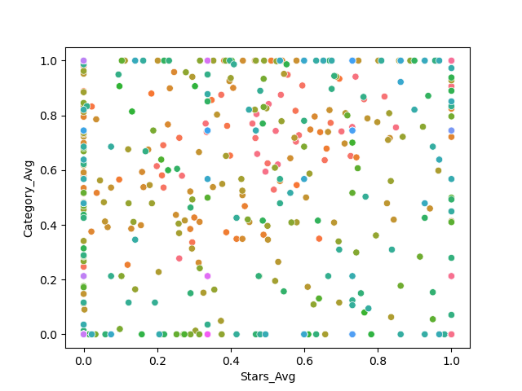

Slide 20

Similarity
Cosine Similarity
Euclidean Similarity
Measure the angle between two vectors
Measures the Distance between two points regardless of dimension

Slide 21
Results
Original
Original
 | Cosine | Euclidean
Star-Category | 87.389% | 705.3985
Unnormalized
Normalized
Merged
 | Cosine | Euclidean
Star-Category | 94.448% | 45.556
Business-Category | 19.596% | 14270.078
Business-Star | 19.886% | 14274.6103
Normalized
 | Cosine | Euclidean
Star-Category | 63.736% | 15.076
Business-Category | 61.080% | 15.0812
Business-Star | 43.848% | 17.596
Notes:
-----Base Data Similarity-----
Cosine Similarity: 0.9044766845769848
-----Base Data Combined Similarity-----
Cosine Similarity: 0.9998271383019207
Euclidean Distance: 18021.585037115907
Jaccard Similarity: 0.05486725663716814
-----Normalized Data Combined Similarity-----
Cosine Similarity: 0.9948703360087581
Euclidean Distance: 0.6511415334686608
Jaccard Similarity: 0.05673758865248227
Before Combining by cities the cosine similarity was 90.45%

